Slide 1



INTRODUCTION TO QUERY STORE
Carlos Robles
MSc, MCP, MCTS, MCSA, MCSE, ITIL v3
Multi-platform DBA
@dbamastery
dbamastery@gmail.com
www.dbamastery.com
www.sqlguatemala.com

Slide 2
Agenda
Introduction
What is Query Store
Architecture Overview
Configuration
How to use Query Store
Demo
Best Practices
Considerations

Slide 3
REAL WORLD scenarios …
After upgrading a SQL Server instance to latest version, had issues with plan changes slowing down the front end application
Had a performance problem with a database and was unable to determine the root cause because someone decided to reboot the server
Had a third party application experiencing performance problems but no changes to the database schema are not allowed

Slide 4
Had an application down / slow because of the database is not performing well, upper management is expecting you to push the go faster button
Had an application that only uses AD-HOC and dynamic SQL queries
Guess what? Query store can help you with all these situations

Slide 5
What is query store
SQL Server flight data recorder
Captures query plan, runtime and wait statistics
It simplifies troubleshooting by helping to find performance differences caused by query plan changes
It aggregates data by time windows so database usage patterns can be identified
Available for all editions - SQL Server 2016 and Azure SQL DB

Slide 6
WHAT MAKES QUERY STORE SO GOOD
What is the added value?
Makes query tuning less complex
The previous solutions were not part of SQL Server engine
Tracks information independent of what is cached
Stores every SQL statement from a batch
Works at database level
Easy plan forcing (it depends …)

Slide 7
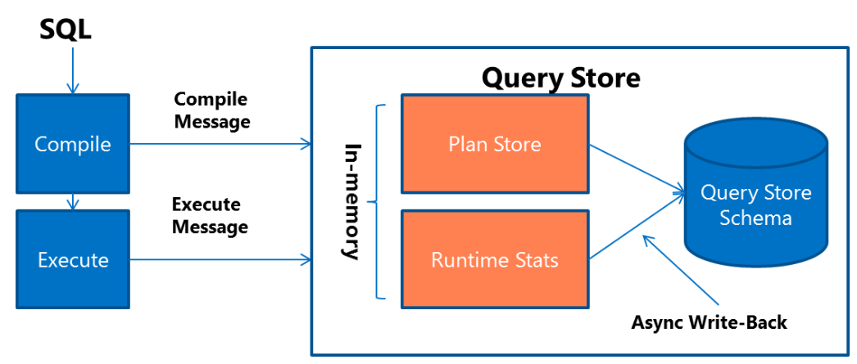
ARCHITECTURE OVERVIEW
Estimated execution plans
Aggregation based on Interval length minutes
Aggregated data flush → Async checkpoint mechanism

Slide 9
Configuration
It is enabled at database level (master, TempDB or model)
Starting from SQL Server 2016 and Azure SQL Database v12
All SQL Server editions
Permissions
VIEW DATABASE STATE
DB_OWNER
T-SQL
ALTER DATABASE MyDatabase SET QUERY_STORE = ON;

Slide 10
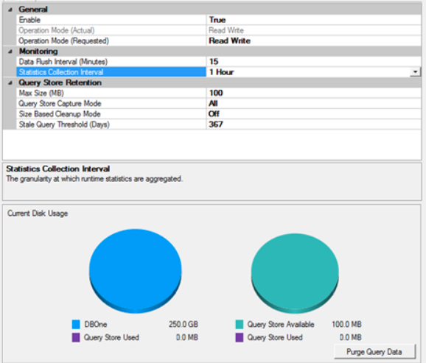
SELECT * FROM
sys.database_query_store_options;

Slide 11
Options related to data COLLECTION
Operation mode
Default Read-Write
Read Only
Query capture mode
Default ALL for SQL Server 2016+
Default AUTO for Azure SQL Server DB
NONE
Max plans per query
Default 200

Slide 12
Options related to data store
Max storage size MB
Default 200 MBs
Cleanup policy
Stale query threshold in days
Default 30 days
Size based cleanup mode
AUTO
OFF

Slide 13
Options related to data AGGREGATION
Interval length minutes
Default 60 minutes
1, 5, 10, 15, 30, 60, 1,440 (24 hours)
Lower values, more granularity
Data flush interval
Default 15 minutes
Flushing runtime and wait stats data from memory to disk
In case of memory pressure data will be flushed to disk immediately

Slide 14
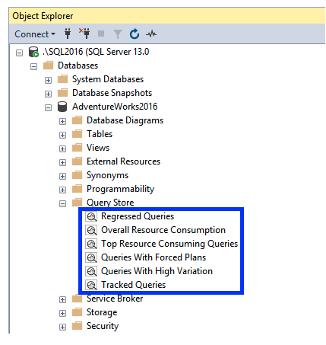
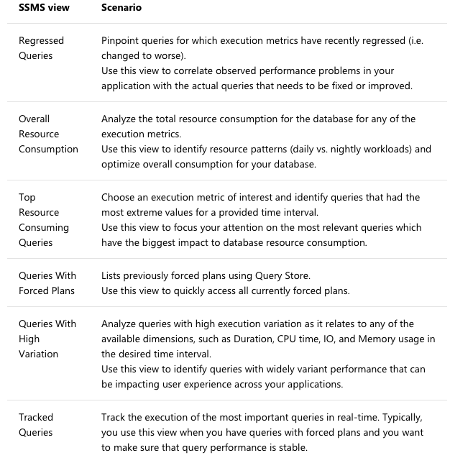
HOW TO USE QUERY STORE

Slide 15
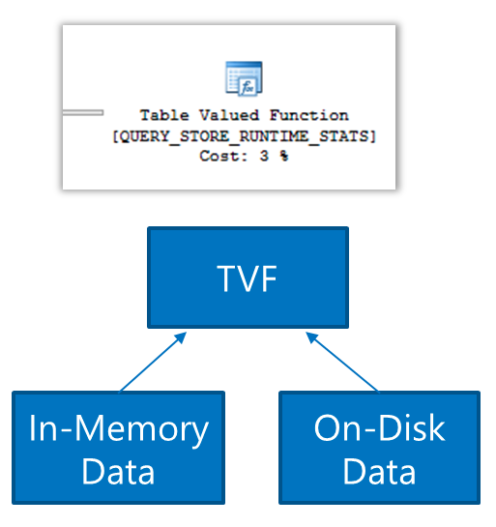
Query Store Catalog Views
sys.query_store_query
sys.query_store_plan
sys.query_store_query_text
sys.query_context_settings
sys.query_store_runtime_stats
sys.query_store_wait_stats
sys.query_store_runtime_stats_interval

Slide 16
Query Store Catalog Views
Plan store
Query plan & query text
Query context settings
Runtime stats store
Compilation time, duration & last execution
CPU & DOP
Logical reads & physical reads
Writes
Wait statistics (SQL Server 2017)

Slide 17
PLAN GUIDES VS QUERY STORE
Plan guide
Forces ad-hoc queries or stored procedures
Object, SQL and Template
Add hints without code changes
Complex
Plan verification (XML)
Query Store
Forces ad-hoc queries or stored procedures
No hints, changes in query text changes query id
No plan verification (XML)

Slide 18
DEMO

Slide 19
RECAP
Pinpoint and fix queries with plan choice regressions
Identify and tune top resource consuming queries
A/B testing, application changes
Keep performance stability during the upgrade to newer SQL Server

Slide 20
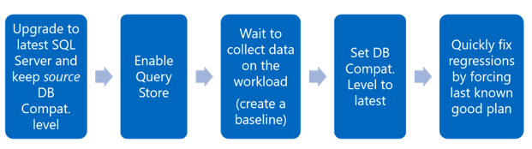
Upgrade workflow

Slide 21
Best practices
SSMS latest version
Update file in case SSMS is already installed
XE monitoring
Trace flags
-T7745: Forces Query Store to not flush data to disk on DB shutdown
-T7752: Enables asynchronous loads of Query Store
Configuration recommended by Microsoft

Slide 22
CONSIDERATIONS
Aggregated data (interval)
CPU additional load ~3-5%
PerfMon
Query Store CPU usage
Query Store logical reads, writes
Query Store physical reads (ASYNC writer)
Database datafile distribution
PRIMARY (For internal objects and Query Store) MAIN (User objects)
Persisted after backup \ restore

Slide 23
For more information
Best practices according to Microsoft
How Query Store Collects data
Monitoring performance by using Query store
Query Store Usage Scenarios

Slide 24
RESOURCES
DBA Master - Query Store checker - Coming soon …
Study your data – SSMS Instance and DB level SSMS reports

Slide 25
THANK YOU!!

